Slide 1
Artificial intelligence & Education
English Final Essay Report
181840070 Ge Ruipeng
Notes:
My topic for my essay is AI, which is a very popular and a hot issue recently. It is clear that AI has influenced our life from different aspects, including education, which is my main focus of the essay. I think all of you have heard more or less about AI and somewhat know how the AI is working. →

Slide 2
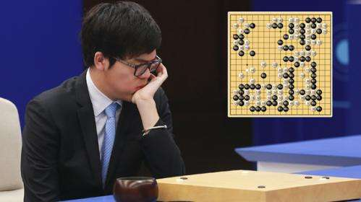
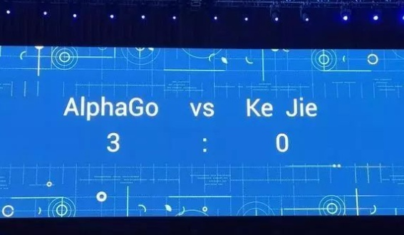
Notes:
And this is where AI caught people’s eyes when Go Game master Ke Jie was defeated by AlphaGo in an Go Game match in China several years ago. At that time, many people have seen the true strength of AI and researches about that has also increased. →

Slide 3
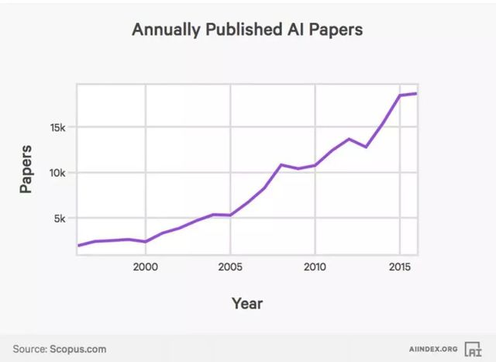
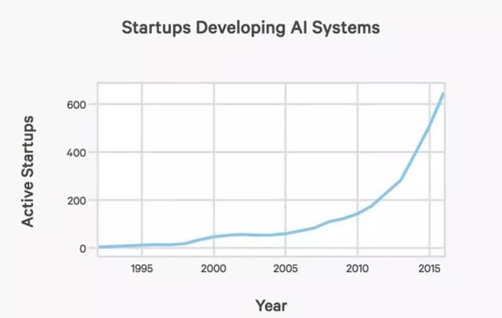
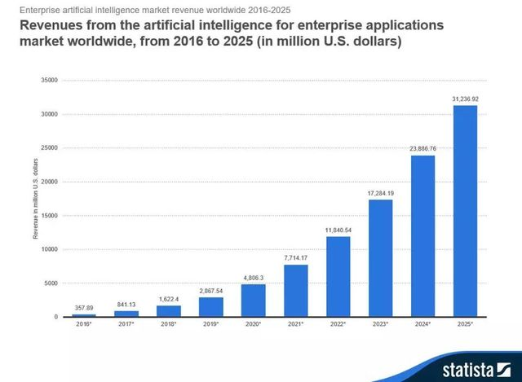
Artificial intelligence
Features:
Rapid development
Wide application
Notes:
In that case, more and more companies and industries have developing or applying AI to help them make a large fortune, and we can see from the graph that revenues from AI expected will grow exponentially from 2016 to 2025. Also, the technology of AI has rather wide application range that it can not only be applied in computer science, but also in manufacturing, medical assistance, and, of course, education. →

Slide 4
How can artificial intelligence affect education?
Notes:
So in terms of my essay, I mainly focuses on “how artificial intelligence affect the pattern of education”. →

Slide 5
Q1: What is AI?
Use machine to simulate human intelligence.
Notes:
Before we talk about the influences about artificial intelligence, we should make clear that how artificial intelligence works. So my first topic about my essay is “What is artificial intelligence”? After I search several materials, together with my own understanding, I use the sentence here as the definition of AI. (Read) →

Slide 6
Q1: What is AI?
Use machine to simulate human intelligence.
Based on algorithm
Computing in fast speed
Automatic
Able to learn
Perform cognitively
Notes:
Machine: (artificial) It is like kind of certain software in your personal computer. And if ur familiar with programming, and you probably know making software needs writing several programs and each program act in a certain way under the control of its algorithm. And we know machines can compute in a very fast speed (much faster than we could ever imagine).So it allows the machine to work automatically.
Intelligence: rehash the algorithm itself.

Slide 7
Q1: What is AI?
Use machine to simulate human intelligence.
Chess Game
Algorithm
Input gameboard
Simulating
Find the best solution
Gameover
Adjust variables according to the game result
Notes:
(explain)
After we know something about AI, we can discuss the influence it makes to our education →

Slide 8
Q2: How AI related to education?
In terms of
teaching quality
The need of talents
in certain aspects
Artificial intelligence
Improve
teaching methods
Guide the orientation of talents cultivation
Efficiency
(education itself)
direction
Notes:
the main part of my essay.

Slide 9
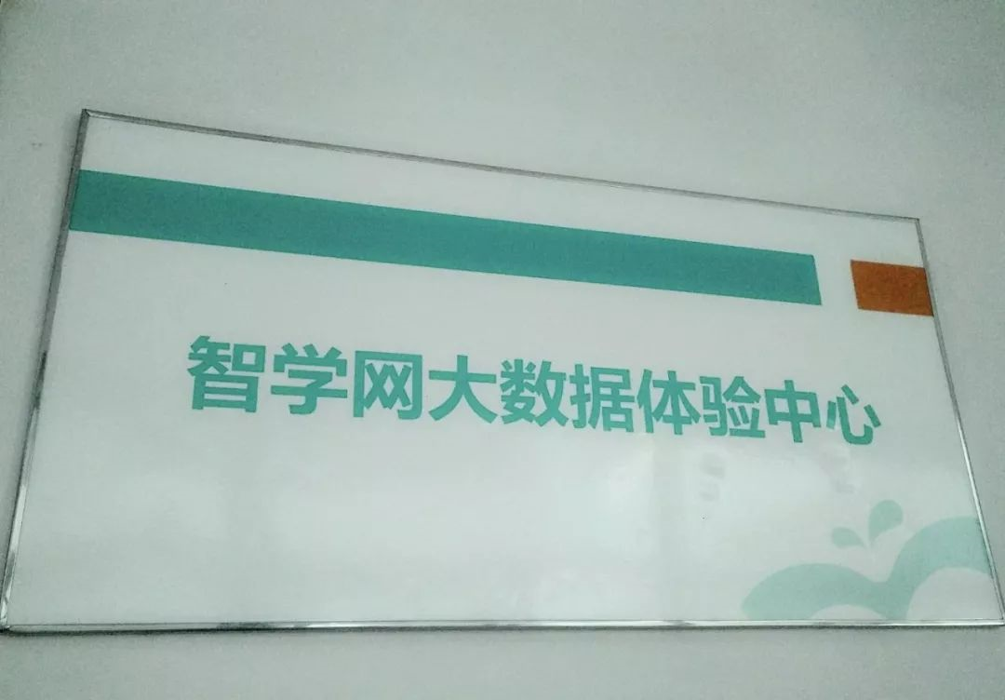
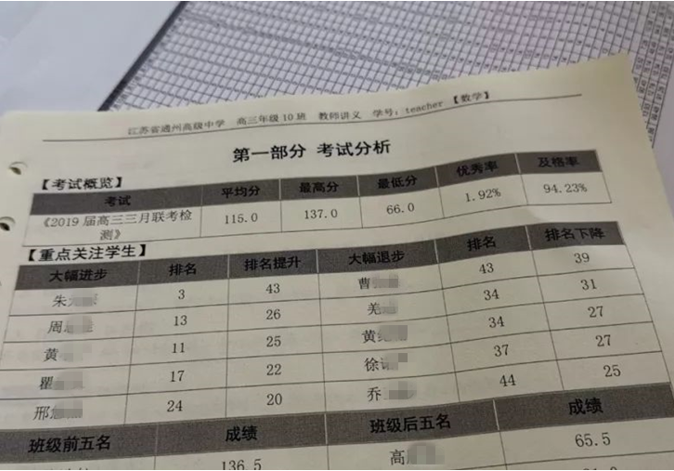
Improving teaching method
Big class size
Learning situations and requirements vary from student to student.
Make individual study plans;
Keep tracking & analyzing;
Give feedback.
Notes:
The size of classes (especially in China) is very large and it is impossible for teachers to catch up all the learning situation of every student. By the way, every student has their own requirement on education. So we can use AI to better meet the need of their individual study plans.
Help teacher catch the main weaknesses of their students by analyzing big data.

Slide 10
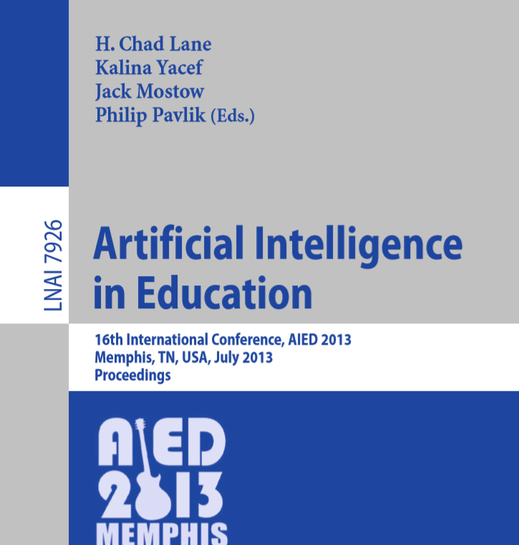
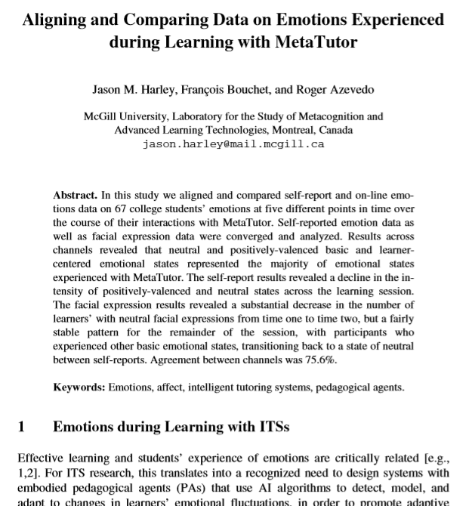
More researches on AI applied in education
Notes:
This is only the simplest way of the application of AI, and many other researches on AI applied in education has progressed and some more advanced methods were invented to make education more efficiency. → second part

Slide 11
Talent-cultivation orientation
Low-intelligence work
AI Labor
High processing speed Low-efficient
Hardly making mistakes Less accurate
Able to work for long Easily getting tired
More efficiency & effective
Replaced
Notes:
Just now, we have talked about the features of AI that is they process in a very fast speed, and they are very good at repeating what they are told to do. So machines are much better than human in calculating data and doing some manual work, (low-intelligence work)
This has set alarms for us that being a bookworm is useless in the competitive society. And we need to focus on how to cultivate the creativity of our kids, which is more helpful in designing certain kind of machine to help them work out some problems (let their work get more efficient)
Be aware that (though replace) other jobs created for high-intelligent individuals.

Slide 12
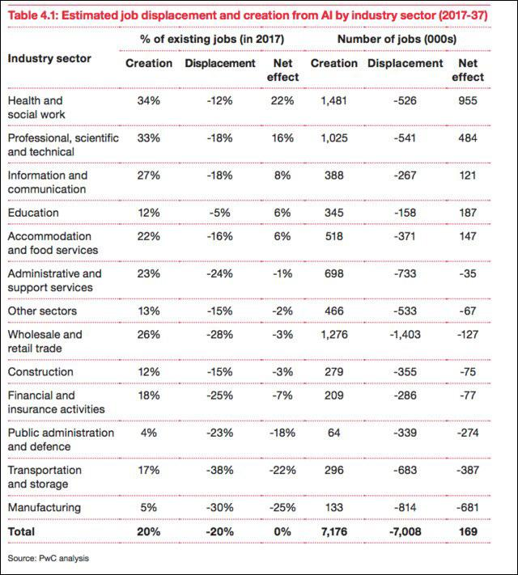
AI’s influence on employment
Manual labors tend to be replaced;
High-intelligence jobs are created.
Notes:
For the instructors, we should be aware of the current social employment pattern and go with the tide of our time.
The society is getting more and more competitive, so we should equip ourselves with talents and creativity to really make our work and life more effectively.

Slide 13
Summary
1. Definition & Features of AI;
Use machine to simulate human intelligence.
2. Influence I: Improve teaching quality
Keep tracking & evaluating student’s learning situation;
Other applications on education.
3. Influence II: Guiding Talent-cultivation
Gain knowledge to fit for the high-intelligence work.
Conclusion:
A big revolution on education;
Our society will work more efficiently.

Slide 14
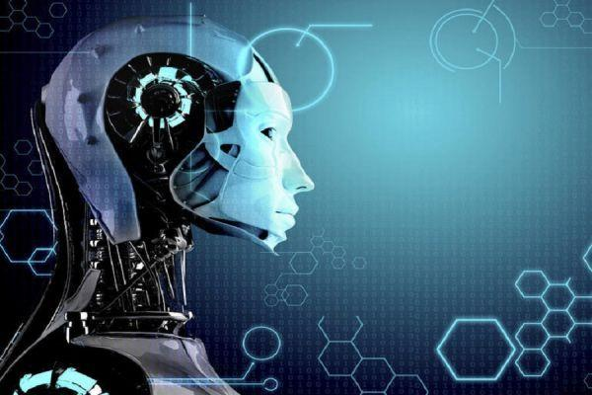
Thank you
Artificial intelligence & Education

